Slide 1
SMART HOME
Presented by- Lopamudra mohapatra
branch - CSAI (ii)
guided by- prof. sahasranshu das

Slide 2
contents
introduction
core components
cost saving
home security with smart technology
automation
growing eco system of smart appliance
privacy security
future trends in smart home
conclusion

Slide 3
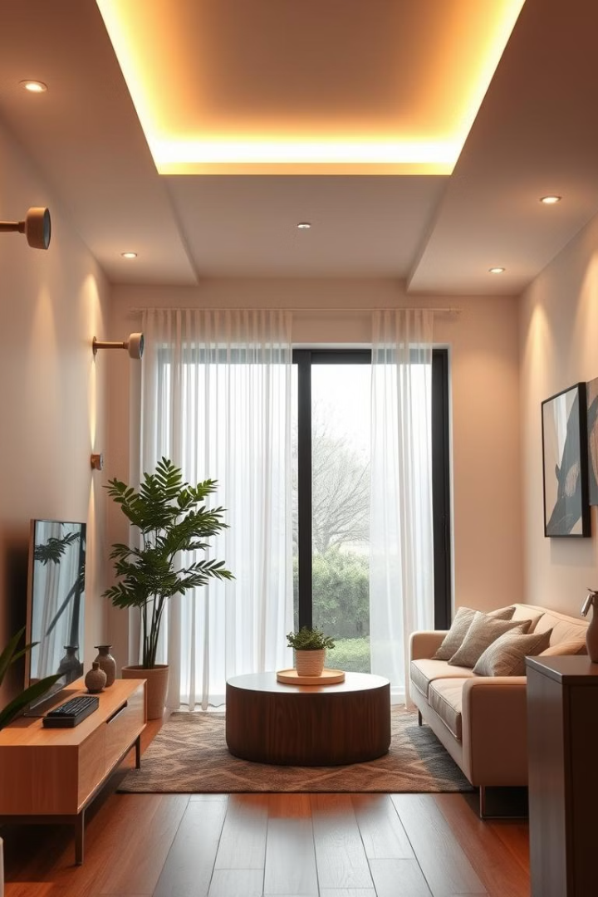
introduction
Embark on a journey into the world of smart homes. Discover how they are changing the way we live. Experience a new level of security and comfort.

Slide 4
Core Components of a Smart Home
Smart Hubs
Smart devices:
Central control units manage communication. Examples include Amazon Echo and Google Home. They utilize protocols like wifi
These include smart lighting such as Philips Hue.. Security systems like Ring and smart appliances are included.

Slide 5
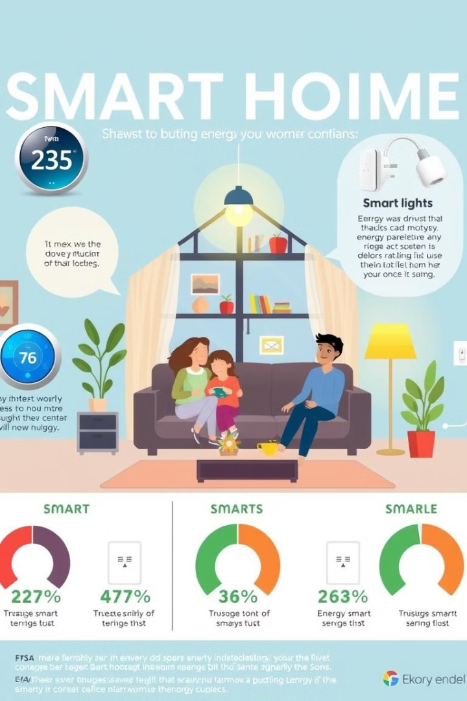
Energy Efficiency and Cost Savings
1
Smart Thermostats
2
Smart Lighting
it is a device that controls your home heating and colling. Save 10-12% on heating. Save 15% on cooling.
a system where we control our lights using smart phone. LEDs use 75% less energy. .

Slide 6
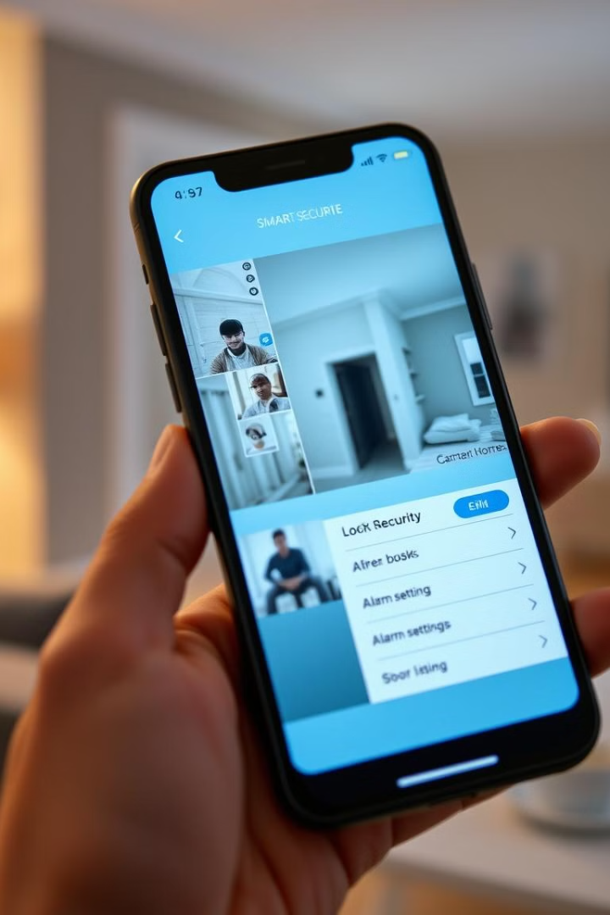



Enhancing Home Security with Smart Technology
Smart Security Systems
Smart Cameras
Smart Locks
Monitor real-time video in HD. Receive motion-activated alerts. Use facial recognition.
Enjoy keyless entry. Lock and unlock remotely. Track activity logs. Issue temporary access codes.
Wireless sensors detect intrusions. Professional monitoring is available 24/7. Arm and disarm remotely.

Slide 7



Convenience and Automation
2
Smart Routines
1
Voice Assistants
Automated Shades
3
Voice control lets you manage devices easily. Set alarms, play music, and answer questions. Create routines to automate actions. Automate shades based on time or sunlight.

Slide 8
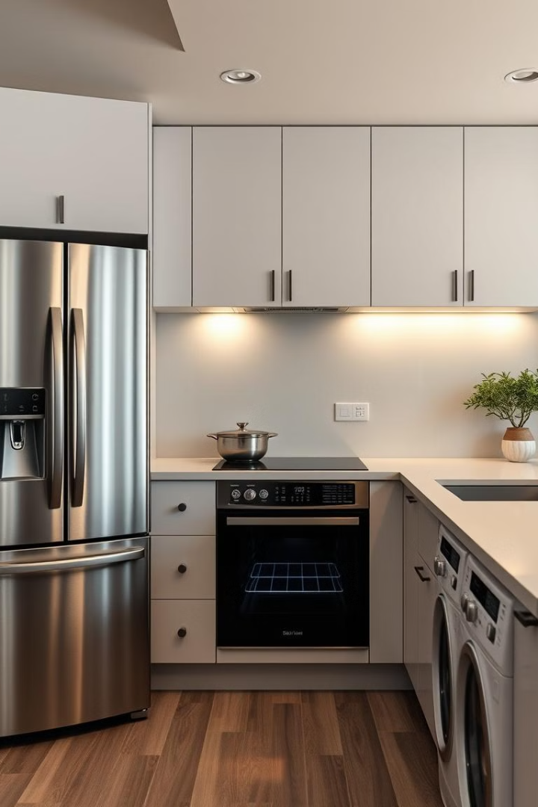



The Growing Ecosystem of Smart Appliances
Smart Refrigerators
Use the built-in touchscreen. Monitor temperature and energy usage.
Smart Washers & Dryers
Start and stop cycles remotely. Get notifications when laundry is done.
Smart Ovens
Preheat and control temperature remotely. Use voice commands.

Slide 9

Addressing Privacy and Security Concerns
1
Data Encryption
Encrypt all data. Use strong passwords .Privacy Settings
Review and adjust settings. Limit data collection. Opt out of personalized ads.
2
Network Security
Secure your Wi-Fi with WPA3. Use a firewall. Update device regularly.

Slide 10
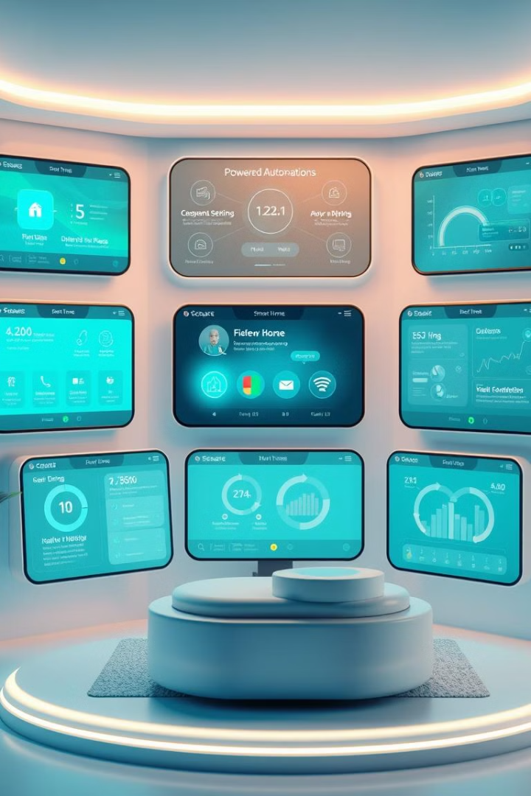
Future Trends in Smart Home Technology
AI and ML
Health Applications
Tailor settings to your preferences. Improve voice control.
Smart beds track sleep. Air purifiers monitor air quality. Wearables provide health data.

Slide 11

conclusion
Smart homes offer energy efficiency and security. They provide convenience and comfort. Smart homes represent the future of living.

